Slide 1
Stable Diffusion with
Brain Activity

Slide 2
The Promise
You will learn about the principles behind diffusion
An approach to reconstructing images from brain fMRI

Slide 3
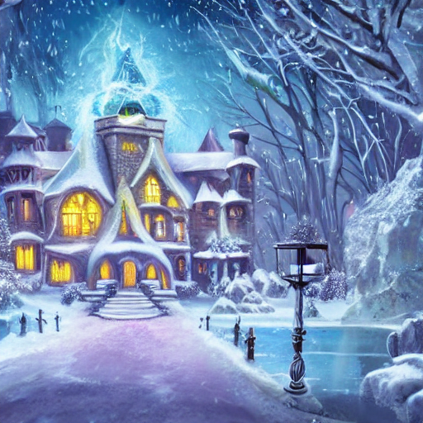
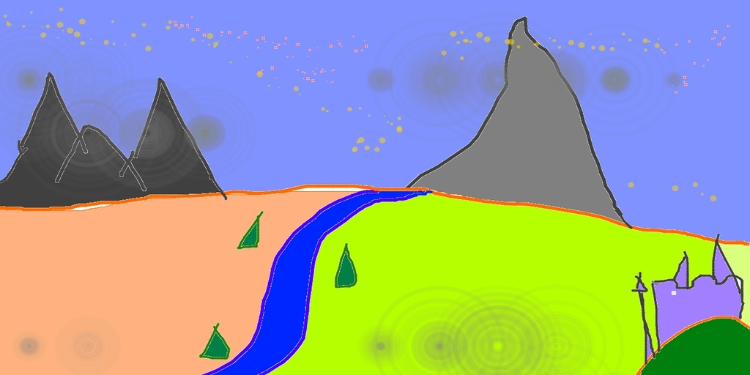
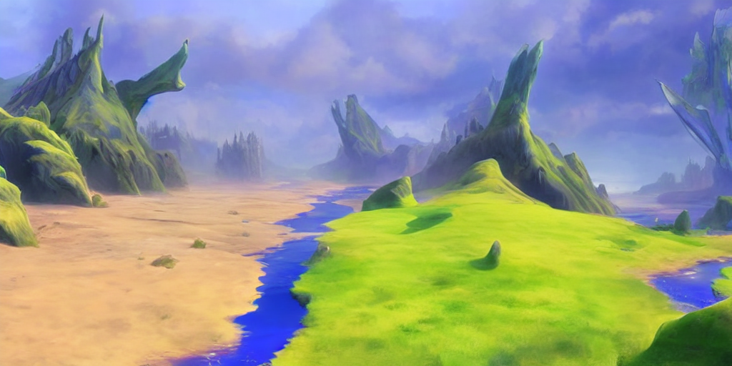
What is stable diffusion?
Text to Image generation
Wizard magic school in the winter
Image to Image generation
Notes:
Mention latent diffusion models and other ldms (dalle)

Slide 4
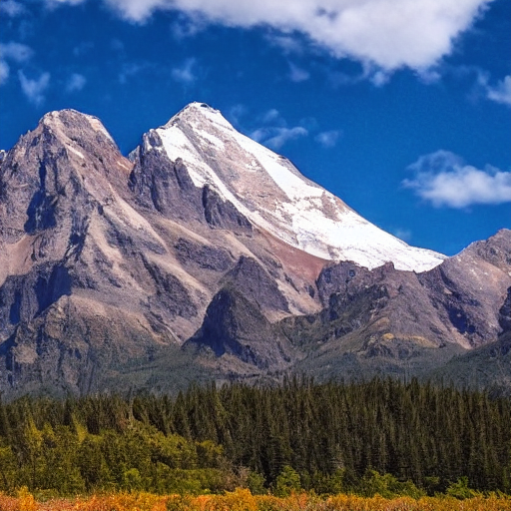
Architecture of Stable Diffusion
Text Prompt: “Mountain”
CLIP
(Text Embeddings)
UNet (Diffusion)
VAE (autoencoder)

Slide 5
How does Stable Diffusion Work?
Encode user’s text prompt to its text encoding with CLIP
Use UNET to perform diffusion process guided by text encoding
Use VAE to transform UNET output to an image

Slide 6
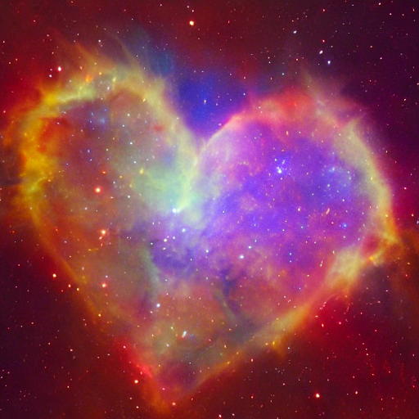
Overview
CLIP Encoder
Text prompt
Random Tensor
Image Information
Diffusion Process with UNet

Slide 7
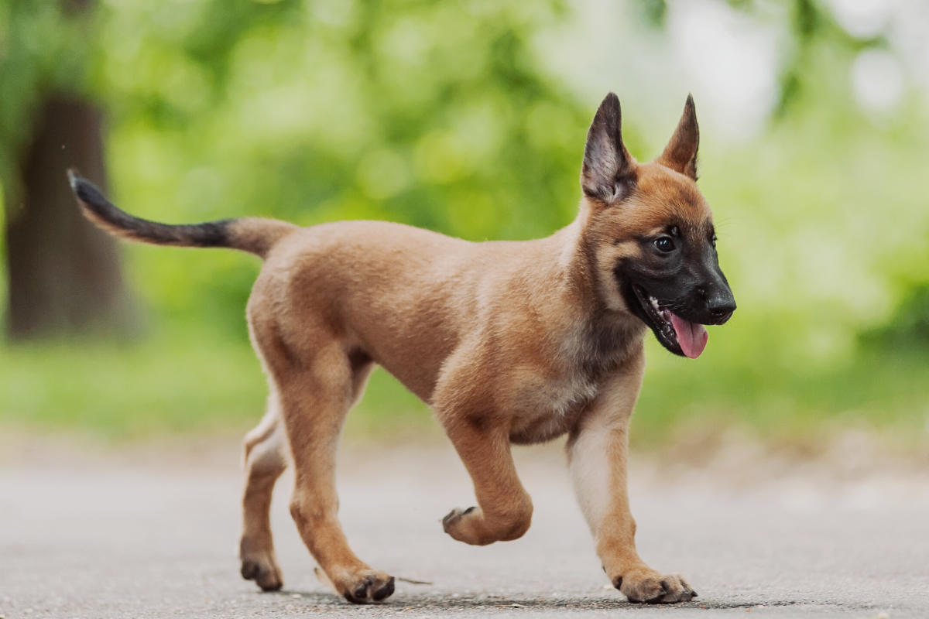
CLIP Model
(Contrastive Language–Image Pre-training)
Text encoder
“A puppy walking in the park”
Image encoder

Slide 8
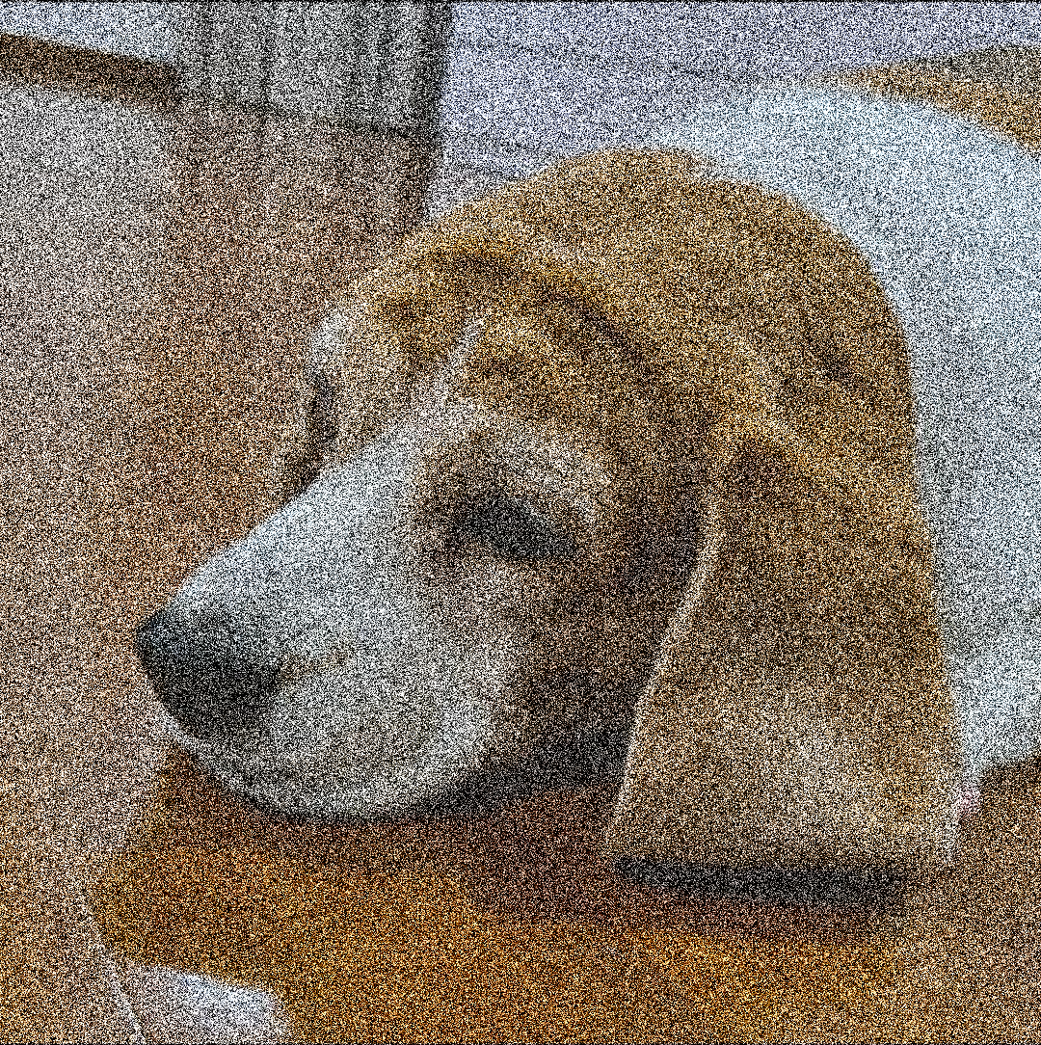
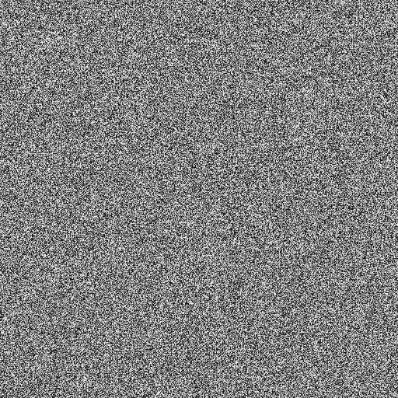
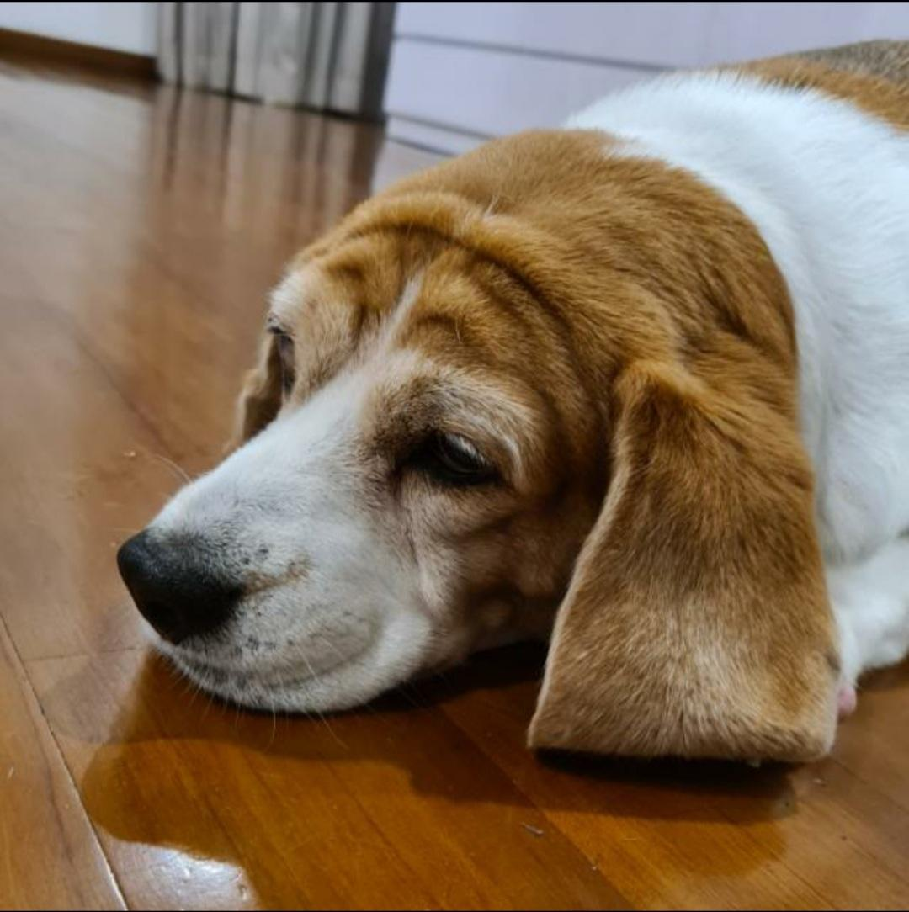
Diffusion Process
Input
Prediction
Model
Key Idea
-
=

Slide 9
Inverse Diffusion Process
Forward Diffusion
t0
t1
……………………………………….
t11
Key Idea:
Reconstructing OG image from noise
Inverse Diffusion
t11
t0
Notes:
Each step of inverse diffusion goes through unet model to predict noise then subtracted
Unet model is the same so information of the steps (might see this as ddim steps in some papers) is fed into the model as input
DDIM = denoising diffusion implicit models

Slide 10
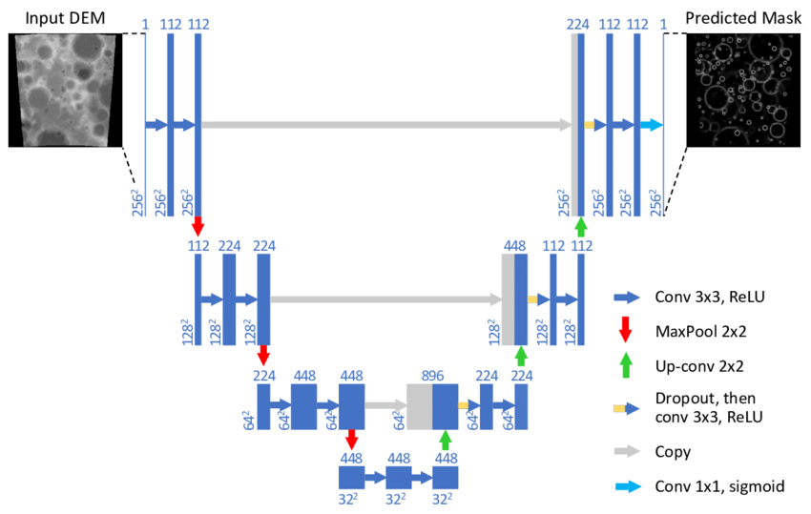
UNET Model

Slide 11
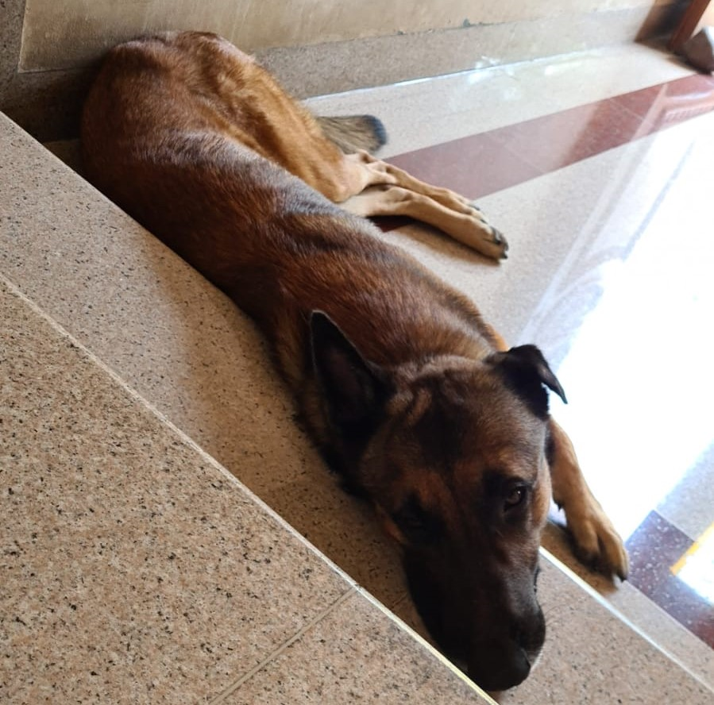
Holistic view of diffusion models
Text embedding
Diffusion process
UNet Model
Random tensor
Image!
Notes:
We have 1 missing step!

Slide 12
Variational Autoencoder (VAE)
Input Image
Reconstructed Image
E
NC
O
D
E
R
DE
C
O
D
E
R
Latent Space
Notes:
Doing it with large images is computationally expensive, doing it in latent space is much faster & cheaper

Slide 13
Latent Diffusion Models (LDM)
CLIP Encoder
Text prompt
Works on the latent space!
Hence, latent diffusion models
Random Tensor
Image Information
Diffusion Process with UNet
VAE
Decoder
Latent

Slide 14
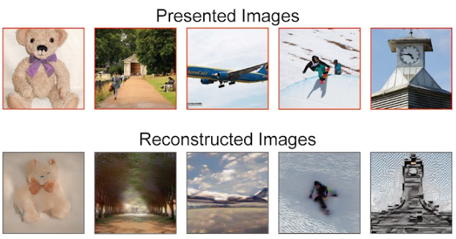
Reconstructing images from brain scans
Yu Takagi & Shinji Nishimoto

Slide 15

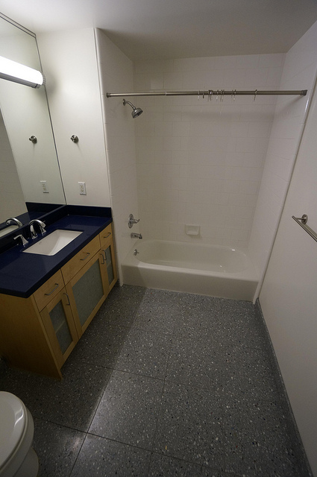
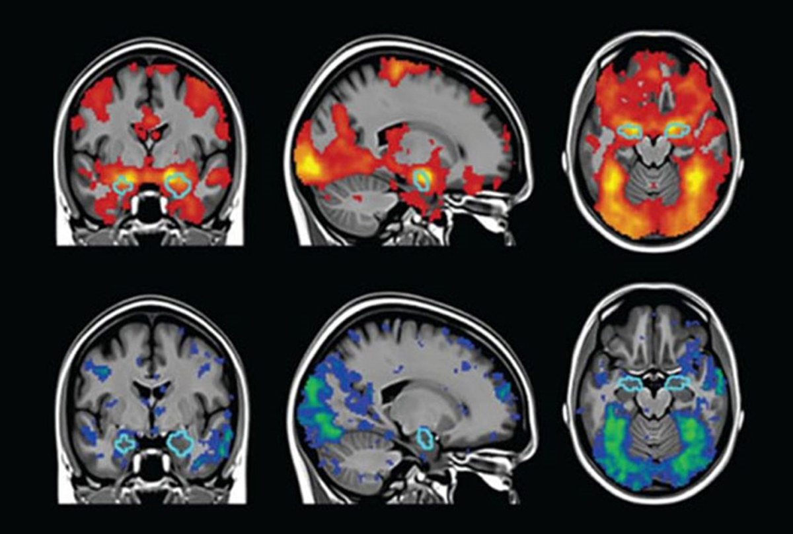
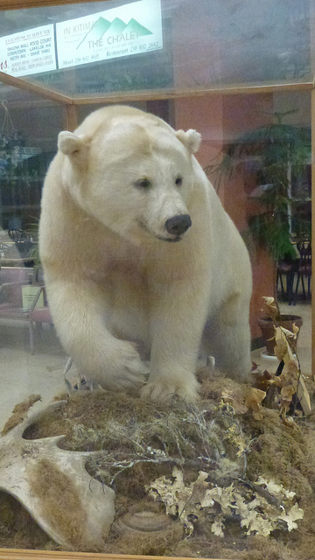
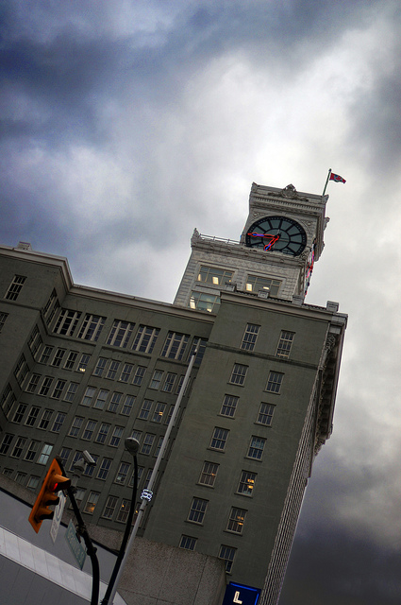
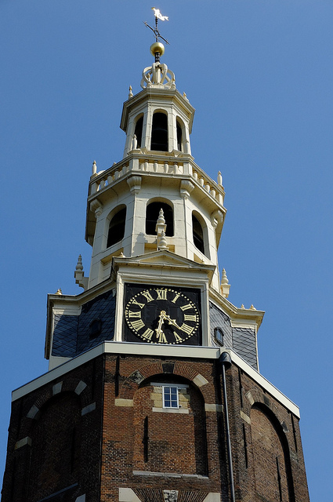
Natural Scenes Dataset (NSD)
Coco Dataset
Notes:
NSD is a large scale fMRI dataset conducted at ultra-high field strength at the Center of Magnetic Resonance Research at the University of Minnesota
Measures brain scans from 8 healthy adults while they viewed thousands of color natural scenes (from coco) over the course of 30-40 scan sessions

Slide 16
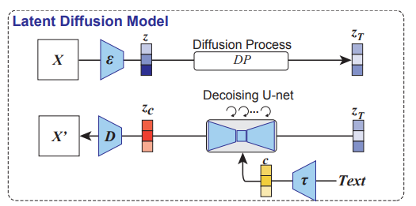
Latent Diffusion Models
Notes:
Facts:
Linear Models were built on a per subject basis with l2 regularized linear regression (aka ridge regression)

Slide 17
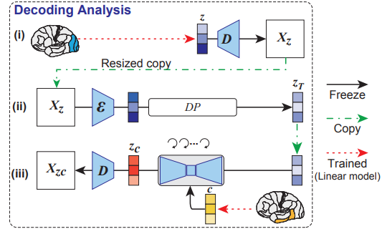
Training the model
Was Random tensor
Was a CLIP model
Notes:
Facts:
Linear Models were built on a per subject basis with l2 regularized linear regression (aka ridge regression)
Z is output from linear model from brain to latent representation of OG image
Passed through a Decoder of VAE with size 320x320 and resized to 512x512
Why decoded instead of going straight to diffusion process? Not quite clear but it seems that the purpose is to resize

Slide 18
“Cute Belgian Malinois”
CLIP Encoder
Random Tensor
Image Information
Diffusion Process with UNet
VAE
Decoder
Latent

Slide 19
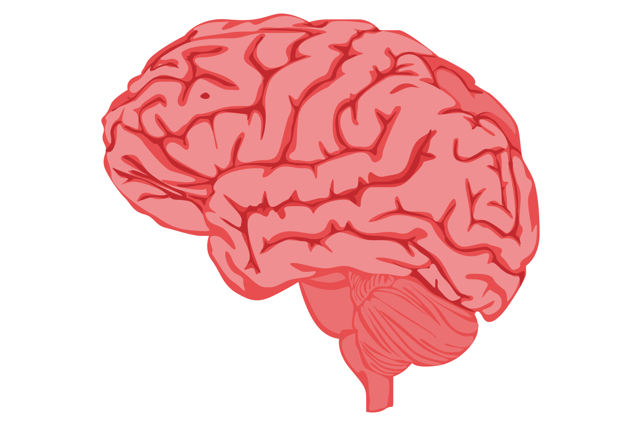
Linear Model
Linear Model
Representation of original image (Z)
Text representation from brain (c)
Diffusion Process with UNet
VAE
Decoder
Latent
Notes:
Linear Model is ridge regression (l2 regularized)

Slide 20
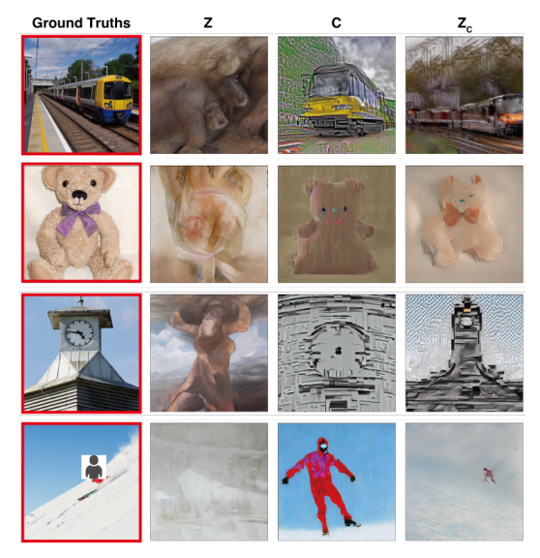
Comparing
Z =
Latent representation of original image
C =
Latent representation of image text annotation

Slide 21
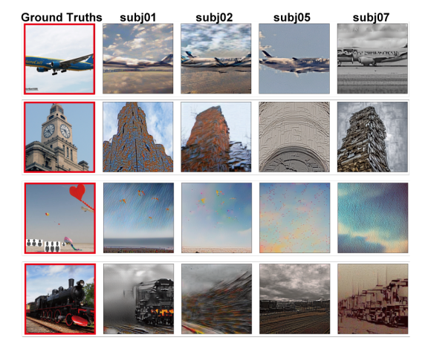
Results

Slide 22
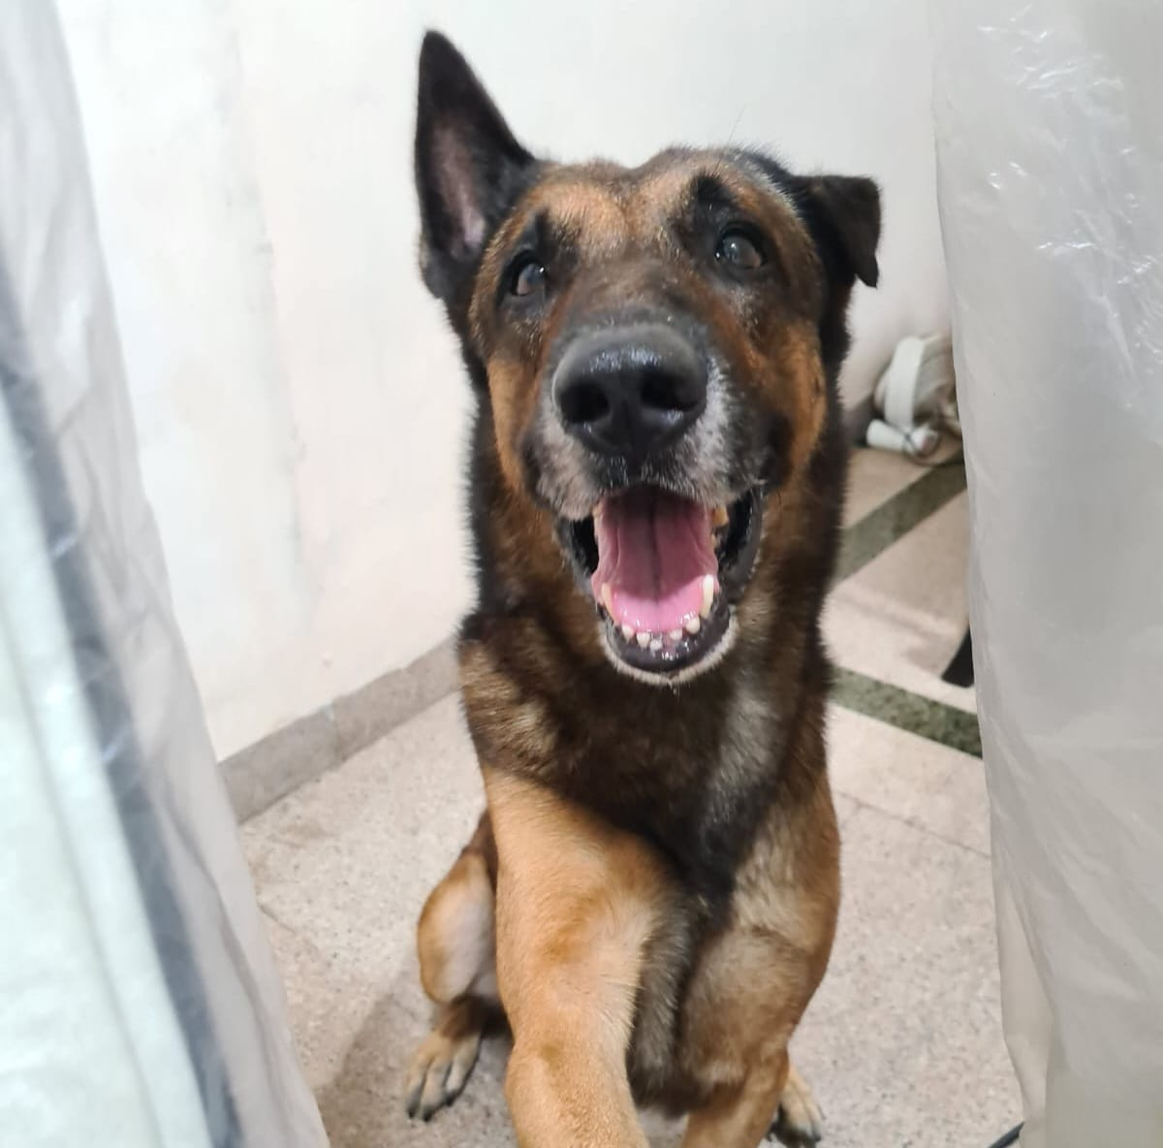
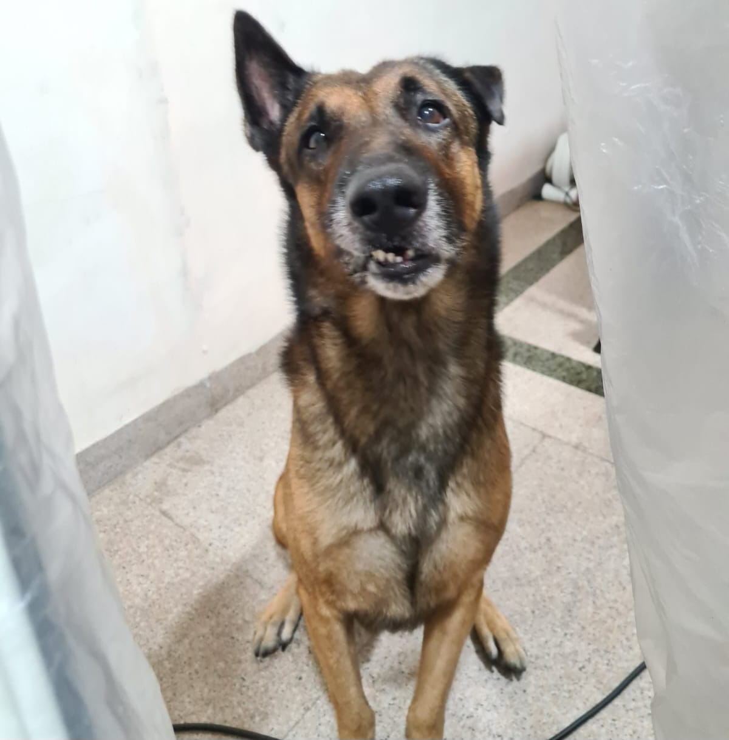
Perceptual Similarity Metrics (PSM)
Original
Objective Evaluation!
Model
(CLIP/AlexNet)
Embedding
Similar?
Model
(CLIP/AlexNet)
Embedding
Generated
Notes:
subjectively (human raters = 6) by assessing whether the original test images (982 images) could be identified from the generated images.

Slide 23
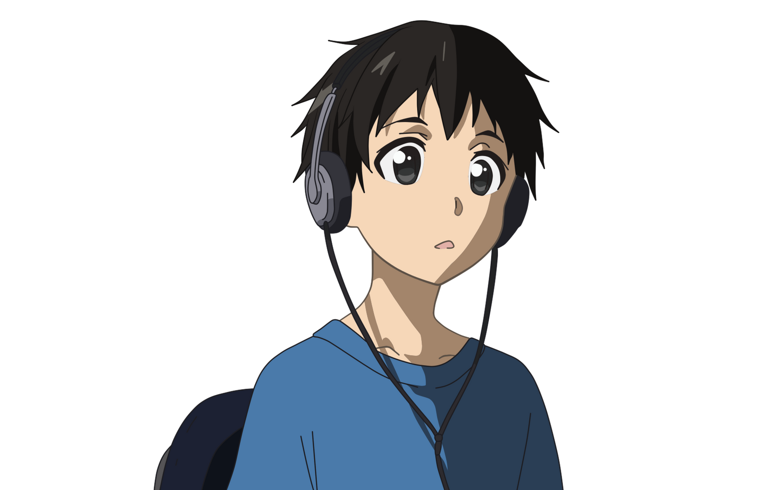
Model Evaluation
(Subjectively) Human Raters!
?
?
?
?
?
?
?
Notes:
subjectively (human raters = 6) by assessing whether the original test images (982 images) could be identified from the generated images.

Slide 24
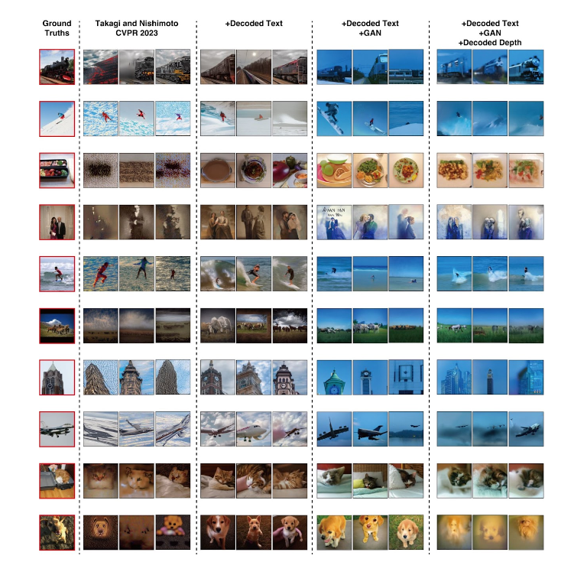
Notes:
Improvements to the work

Slide 25
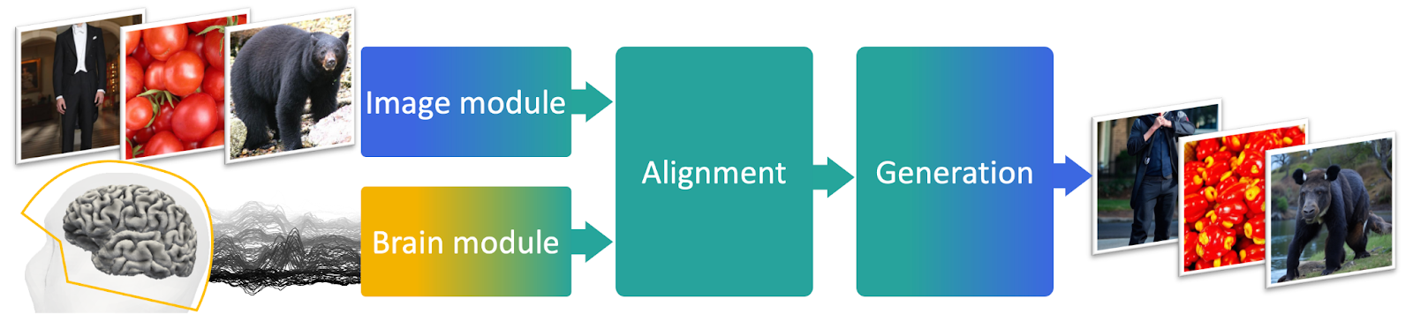

Other Research

Slide 26
Other Interesting Stuff!
(If we have time)

Slide 27
CLIP Model
(Contrastive Language–Image Pre-training)
Text
Embedding
Text encoder
“A puppy walking in the park”
Similar?
Image
Embedding
Image encoder
Notes:
Trained with cosine similarity as loss function

Slide 28
Notes (TO BE REMOVED)
to produce high resolution reconstructions, you needed to fine tune deep generative models on the same dataset used in the fmri experiments. This is difficult as the sample size is small.
NSD dataset (Natural Scenes Dataset)
only training required is to construct linear models that map fmri signals to each ldm component, and no training or fine-tuning of deep-learning models is needed
all models were built on a per subject basis with l2 regularized linear regression
original images was resized from 425x425 to 320x320 but confirmed that resizing them to a larger size (448x448) does not affect quality of reconstruction
Default parameter of stable diffusion model is used
accuracy of the images was evaluated objectively (perceptual similarity metrics) and subjectively (human raters = 6) by assessing whether the original test images (982 images) could be identified from the generated images.
PSM (perceptual similarity metrics) use pretrained models like inceptionnet, alexnet, clip to encode images and compare the embeddings
Early visual cortex fmri to map to image latents (image vae encoder mapping)
higher (ventral) visual cortex fmri to map to latent text representation
Functional magnetic resonance imaging (fMRI) measures the small changes in blood flow that occur with brain activity
Brain scans from coco database

